Slide 1

Innovator’s Day
Topic : Predicting health.
Team Name : Strix Crew.
Team Members : Rohit SK, Sakthimalai P, Vaitheeshvar @ Satyaprakash AT.
Department : Artificial Intelligence and Data Science.
Year/Semester : I/II

Slide 2

We help you to build a better Health
Health And Fitness App for better Lifestyle
Click for more info

Slide 3

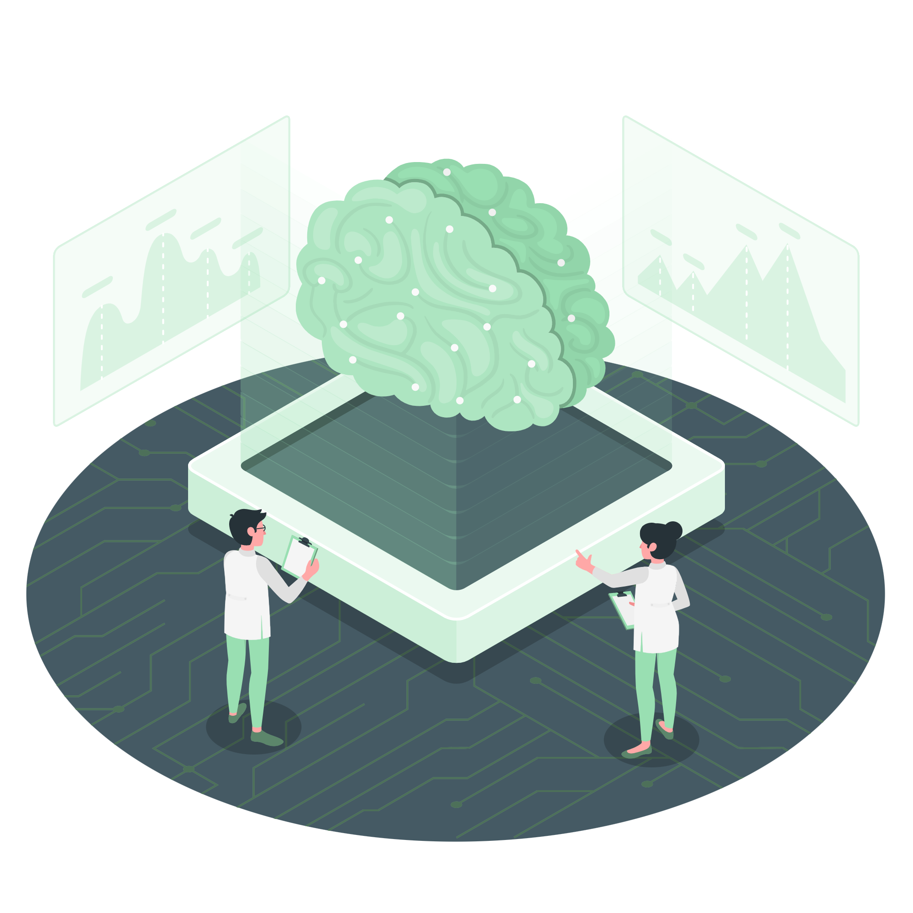
How it is Achieved?
Our Machine Learning Algorithm analyses the data for better prediction of your health.

Slide 4
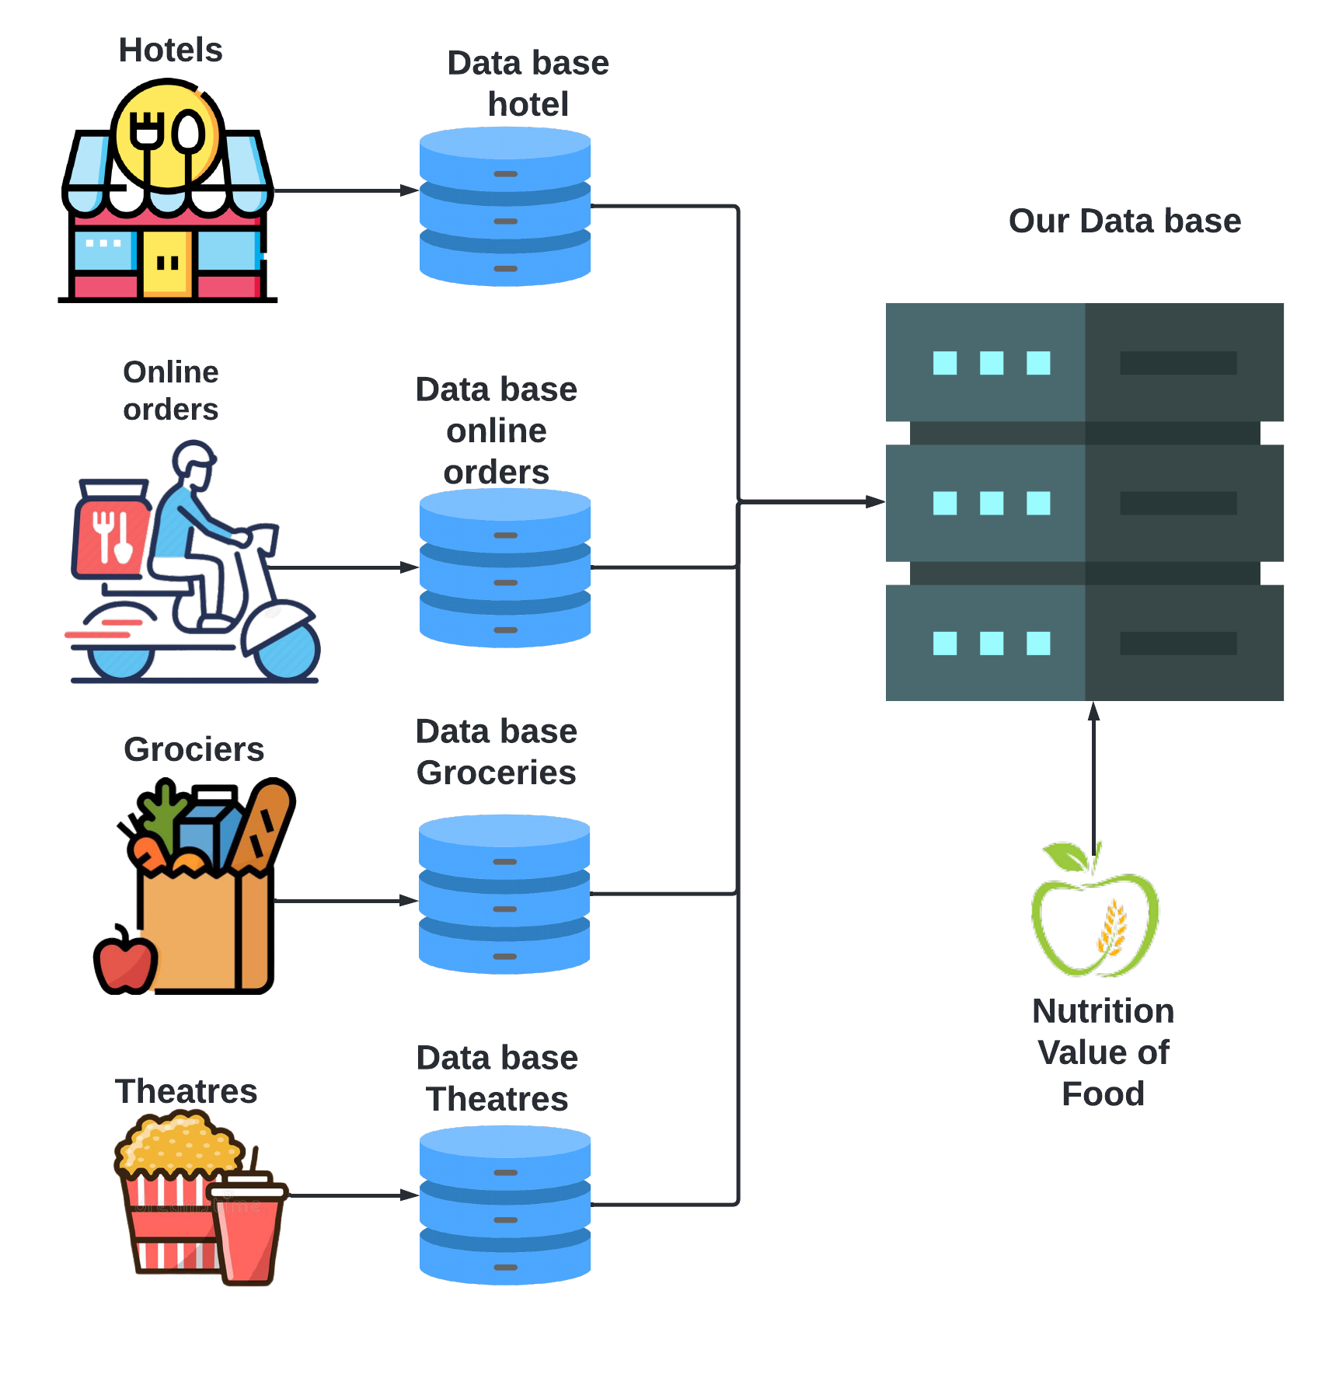
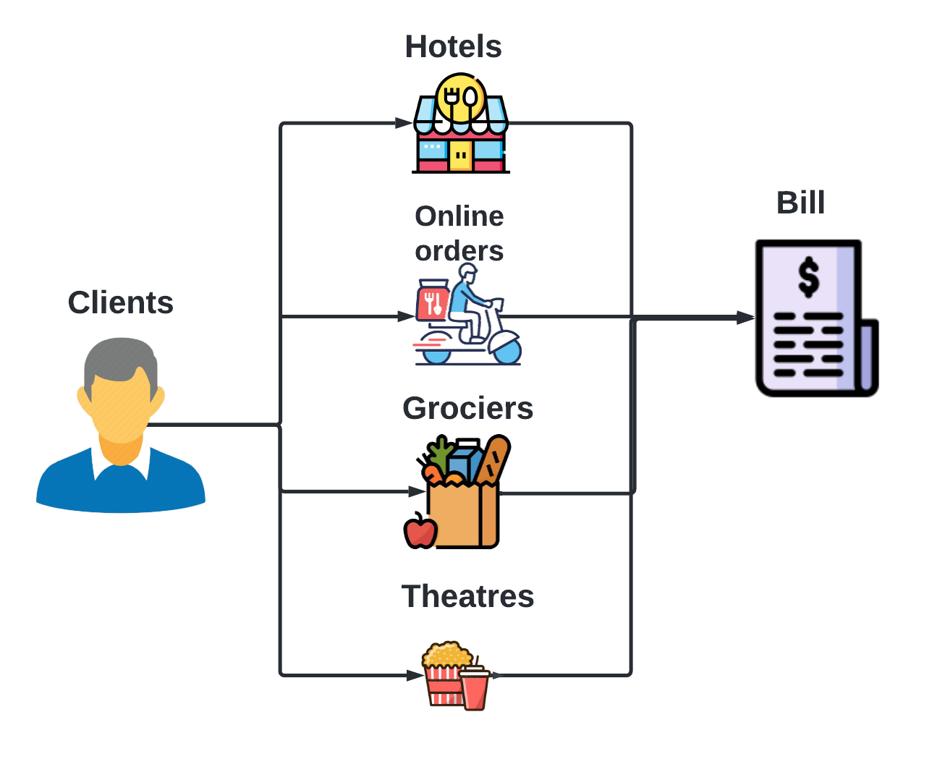
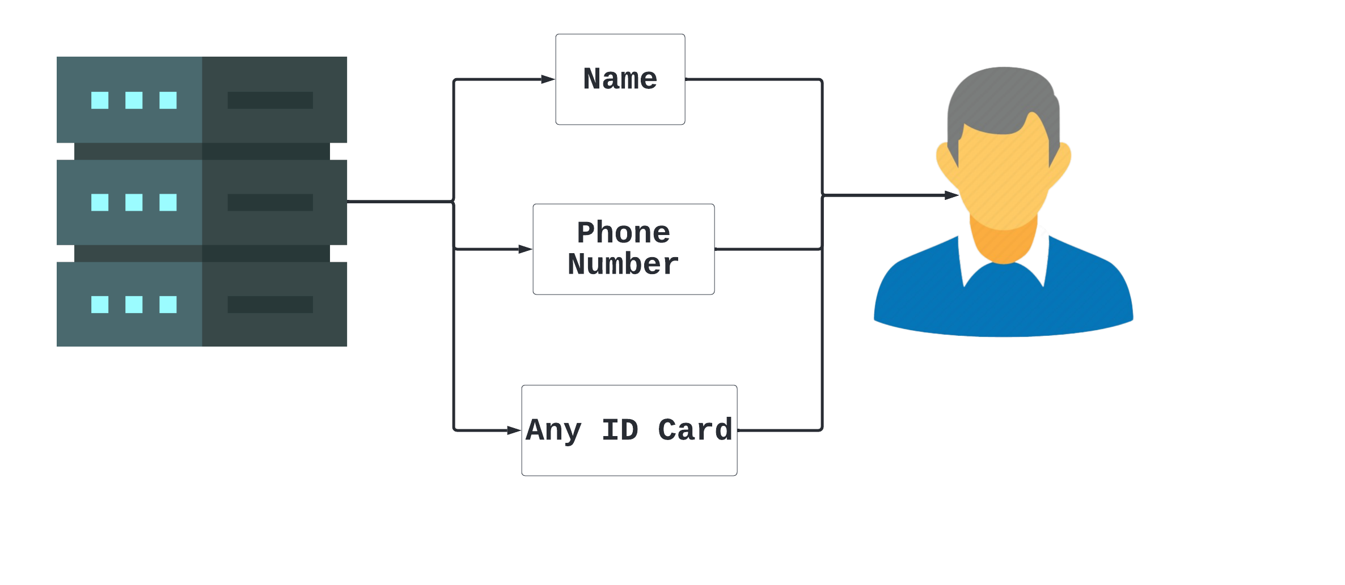
Use Case

Slide 5




Why to choose us?
Top Health App
Our App
Fitness Tracking
Workout
Calorie Tracking
Fitness advisors
Better Voice Assistance
Automated Health analysis
Fitness Tracking
Workout
Calorie Tracking
Fitness Advisors
Manual Input of Food intake

Slide 6

THANK YOU

